Slide 1

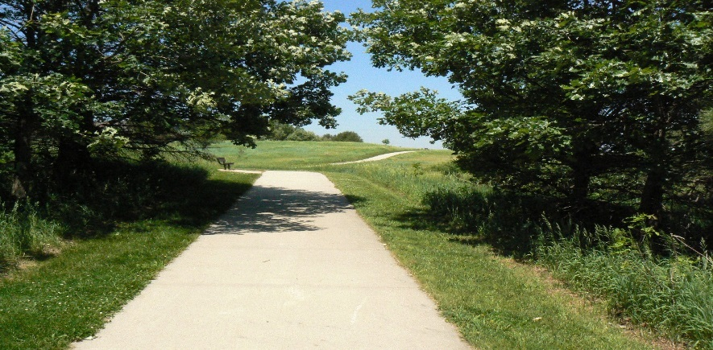
Delaware Division of Vocational Rehabilitation
JDVRTAC Goals Achieved:
Expanded Career pathways Adult Project statewide Year 2017 2018
Delaware Pathways, Pathways to Prosperity National Initiative
(Goal 3-Integrate Education and Workforce efforts for students with disabilities)
Expanded inter-agency partnerships with a focus on Career Pathways
Active Frontline Interaction with DOL Employment and Training, libraries, Adult Education and other WIOA Partners
Annual collaborative all day meetings
Service delivery sharing at staff meetings
Utilization of Labor Market Information with all consumers
Re-bid placement RFP to reflect Career Pathways decision making
Expanded our “how are we doing” survey to 3x consumers, family members, practitioners
Expanded career-focused counseling statewide
Mutual collaboration of resources with DTCC, DOE, Rodel Foundation, Strongpoint Marketing to serve students
2nd annual DE Pathways conference
Career Pathways breakout sessions at annual Transition conference for students with disabilities
Pilot project with NAPE to address goal 3
Specifically to promote access and completion of Career Pathways for students with disabilities at the same rate as students without disabilities
Access to DET summer youth programs and apprenticeships
Partner with Family Service Cabinet Council, DHSS, DSCYF, DOC, DOE to braid resources and share consumers where possible
Represent a Career Pathways focused initiative at various councils, boards, committees
Actively represent individuals with disabilities on DOL Committee for Diversity and Inclusion, and emphasize that everyone can work
Employee Personnel Plans – Incorporated Career Pathways concept into employee Performance Plan and Reviews in year 2017

